Slide 1
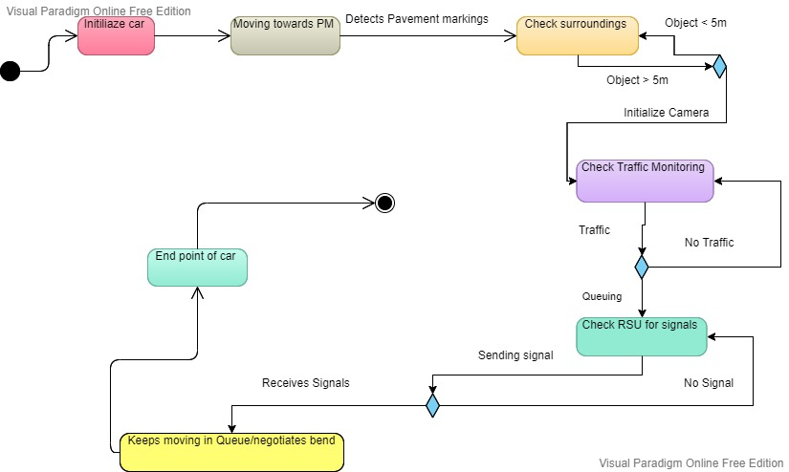
STATE MACHINE V2I COMMUNICATION

Slide 2
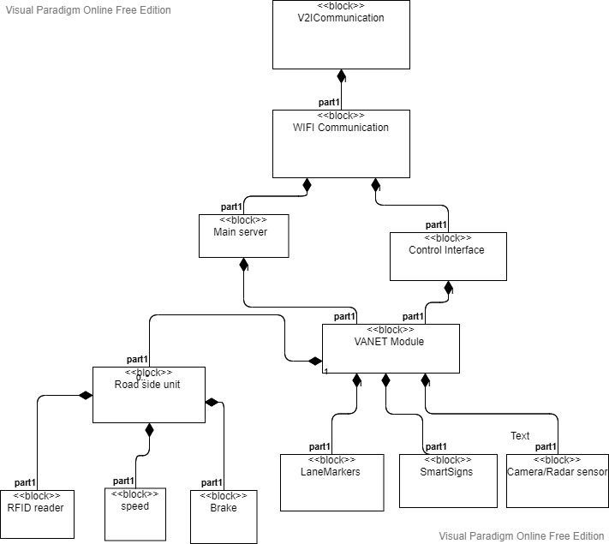
BLOCK DIAGRAM V2I COMMUNICATION

Slide 3
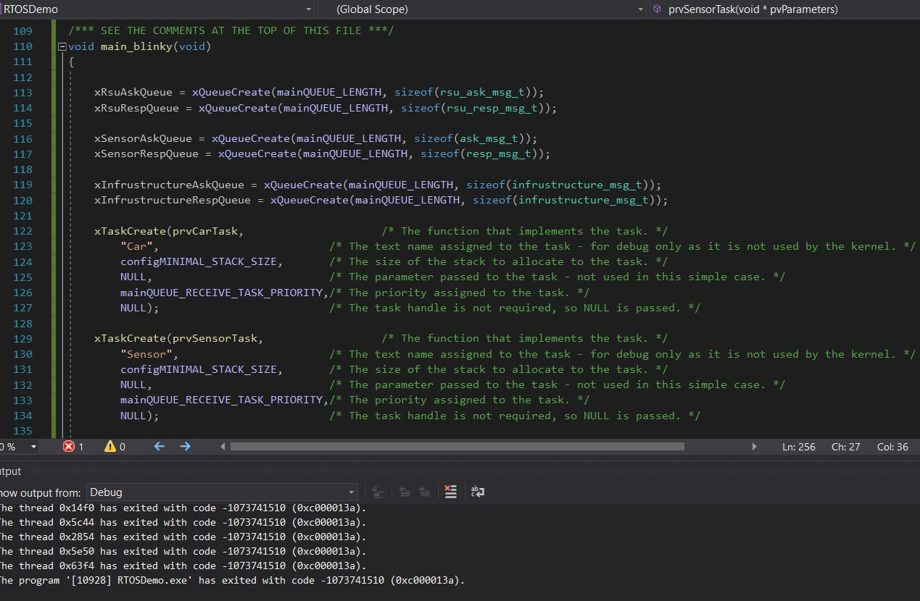
FreeRTOS TASK CREATION

Slide 4
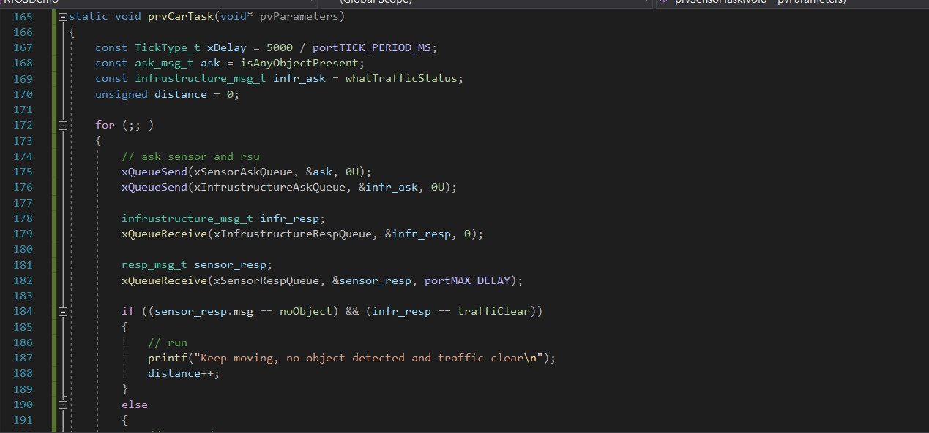
FreeRTOS MESSAGE REQUEST

Slide 5
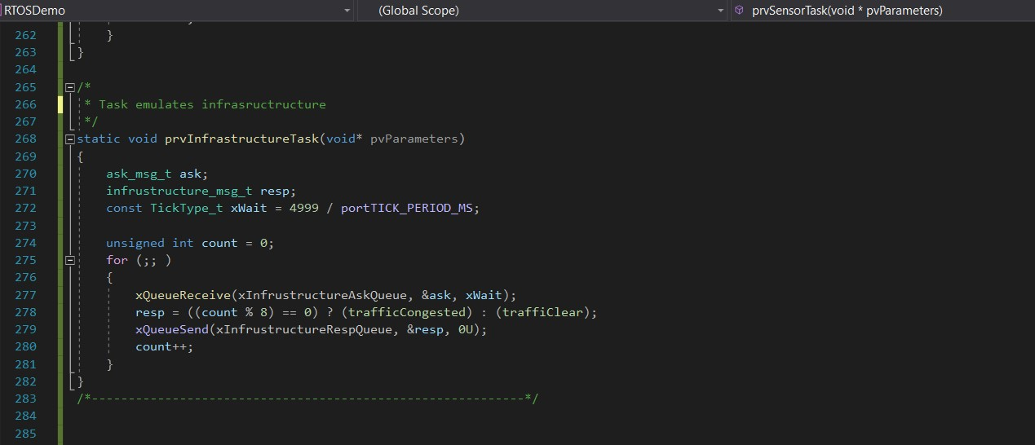
FreeRTOS RECEIVING A MESSAGE

Slide 6
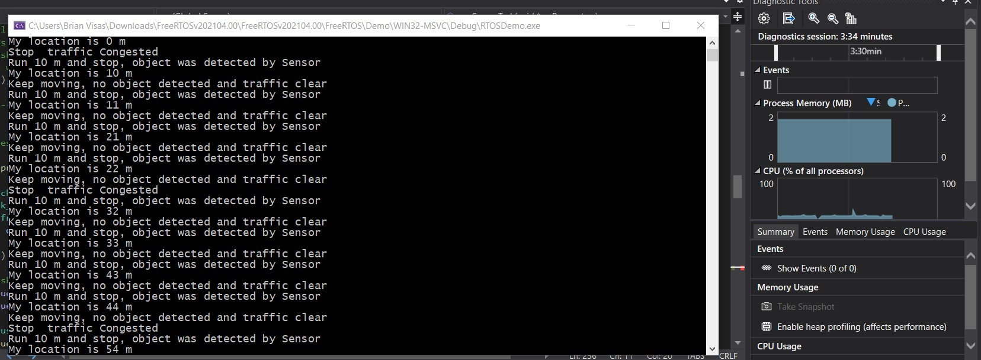
FreeRTOS SIMULATION RESULTS

